Slide 1
Reading, Writing, Phonics and Handwriting Workshop
October 2018

Slide 2
Introduction
The ability to read and write well is a vital skill for all children, paving the way for an enjoyable and successful school experience.

Slide 3
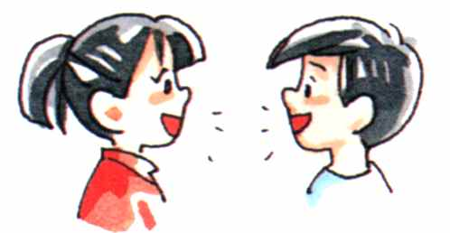
Children’s spoken language supports reading and writing
In order to make a good start in reading and writing, children need to have an adult listen to them and talk to them. Speaking and listening are the foundations for reading and writing.
Books are a rich source of new words for your child; words you would not use in everyday conversations appear in books. Children need to have a wide vocabulary to understand the meaning of books, so read aloud and share books as often as you can. They will enjoy it and it will be useful to them when they come across these words in their own reading later on.

Slide 4
Letters and Sounds
Letters and Sounds is divided into six phases, with each phase building on the skills and knowledge of previous learning. Children have time to practise and rapidly expand their ability to read and spell words. They are also taught to read and spell ‘tricky words’, which are words with spellings that are unusual.
In the EYFS children are expected to reach the end of Phase 4 at the end of the year.
Today I will show you activities and expectations of Phase 1-4 and how you can support your child at home.
I will also show you how Phonics link to your child’s reading, writing and handwriting.

Slide 5
In EYFS your child has already been assessed for Phonics. Your child will learn the sounds but most importantly they will learn how to blend and segment words. These are vital skills when learning to read and write.

Slide 6
Phase 1
Environmental sounds
Instrumental sounds
Body percussion
Rhythm and Rhyme
Alliteration
Voice sounds
Oral blending and segmenting

Slide 7
Phase 2
In this phase children will continue practising what they have learned from phase 1, including ‘sound-talk’. They will also be taught the phonemes (sounds) for a number of graphemes (letters) and which phoneme is represented by which grapheme. They may use pictures ie mnemonics
VC (vowel, consonant) and CVC (consonant, vowel, consonant) words

Slide 8
a as in hat
b as in bat
c as in cat
d as in dog
e as in egg
f as in fish
g as in get
h as in hat
i as in hill
j as in jelly
k as in kite
l as in hill
m as in mat
n as in net
o as in pot
p as in pen
qu as in queen
r as in rat
s as in sun
t as in net
u as in bun
v as in have
w as in wig
x as in extra
y as in you (at beginning of word)
y as in happy (at end of
word)
z as in zebra

Slide 9
Phase 2
Sounds are introduced in sets
Set 1: s a t p
Set 2: i n m d
Set 3: g o c k
Set 4: ck e u r
Set 5: h b f ff l ll ss

Slide 10
Activity: How many words can you make?
s a t p i n m d
Make as many CVC & VC words as you can?
At home have fun using the sound flashcards to make CVC and VC words.
Try adding sound buttons to CVC & VC words.
sat

Slide 11
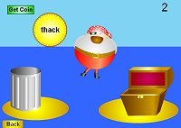
Some activities to try at home * What’s in the Bag? * Phonics Play * Teach Your Monster to Read (individual logins will be sent to you shortly)

Slide 12
Phase 3
The purpose of this phase is to:
teach more graphemes, most of which are made of two letters, for example, ‘oa’ as in boat
practise blending and segmenting a wider set of CVC words, for example, fizz, chip, sheep, light
learn all letter names and begin to form them correctly
read more tricky words and begin to spell some of them
read and write words in phrases and sentences.

Slide 13
Phase 3
CVC words containing graphemes made of two or more letters
Here are some examples of words your children will be reading: tail, week, right, soap, food, park, burn, cord, town, soil
Their confidence from the daily experience of practising and applying their phonic knowledge to reading and writing is really paying off!
Tricky words
The number of tricky words is growing. These are so important for reading and spelling: he, she, we, me, be, was, my, you, her, they, all.

Slide 14
Phase 3
j | v | w | x
y | z | zz | qu | ch | sh | th
ng | ai | ee | igh | oa | oo | ar
or | ur | ow | oi
ear air ure er

Slide 15
Phase 4
Children continue to practise previously learned graphemes and phonemes and learn how to read and write:
CVCC words: tent, damp, toast, chimp
For example, in the word ‘toast’, t = consonant, oa = vowel, s = consonant, t = consonant.
and CCVC words: swim, plum, sport, cream, spoon
For example, in the word ‘cream’, c = consonant, r = consonant, ea = vowel, m = consonant.
They will be learning more tricky words and continuing to read and write sentences together.
Tricky words
said, so, do, have, like, some, come, were, there, little, one, when, out, what

Slide 16
Compound Words
How many compound words can you make using the flash cards below?
card bow sand robe flower sun
shine pan bag rain white moon
castle board pot sauce suit light
black case ward book hand

Slide 17
Phoneme Frames
Ch
i
m
p

Slide 18
How can I help?
Sing an alphabet song together
Play ‘I spy’
Continue to play with magnetic letters, using some two-grapheme (letter) combinations, eg: r-ai-n = rain blending for reading
rain = r-ai-n segmenting for spelling
Praise your child for trying out words
Look at the list of tricky words in your hand out
Look for phonic games
Play pairs with words and pictures

Slide 19
Phonics and how to support your child’s reading
Children have been assessed and given a reading book. Books vary from picture books to books with phonic words. Each week sound cards also come home in your child’s book bag.
Then, children move onto books with tricky ‘high frequency’ words.
Children will be given a copy of the First 100 high frequency words in stages. Children will receive Rainbow certificates to celebrate learning them.

Slide 20
Phonics and how to support your child’s reading
Firstly, make sure that you and the child are sitting comfortably.
At the beginning stages of reading the child should be encouraged to point to the words as he/she reads them (below words).
Sometimes it can help if the adult helper points from above the word too.
Comment on what is being read and on the picture content.
Ask the child to predict what will happen next.
Talk about the story when the book is finished.

Slide 21
If a child gets ‘stuck’, here are some helpful ideas:
Use picture clues.
Ask the child to read on (to get sense of sentence).
Ask the child the initial sound of the work (what sound does the word begin with?). * See index of letter sounds at the back of this booklet *
Never delay too long in giving the word if above strategies fail.
Re-read that sentence together (for reinforcement/fluency practice).

Slide 22
Talking about books is very,very important – ask lots of questions about the text:
Why did that happen?
What happened next?
Where/When did it happen?
How do you think it will end?
Which was your favourite part?
How did xxx feel?
How do you know that?
Who are the main characters in the story?
Was there a part in the story that was sad/happy/funny/etc?

Slide 23
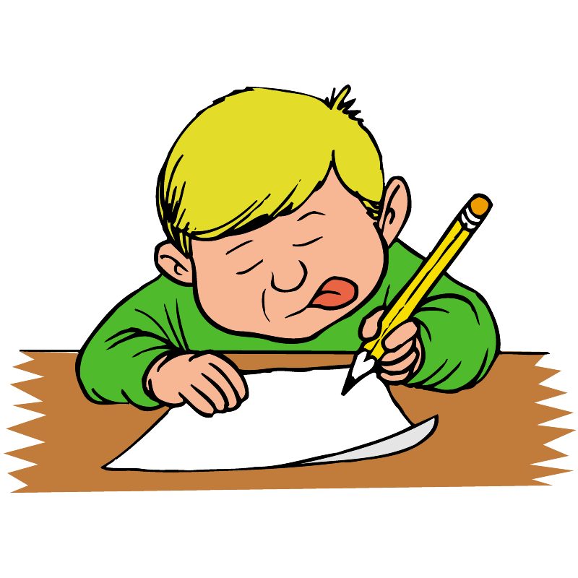
Writing

Slide 24
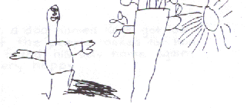
EMERGENT WRITING STAGES
Stage 1
- uses drawing to stand for writing
- believes that drawings / writing is communication of a purposeful message
- read their drawings as if there were writing on them

Slide 25
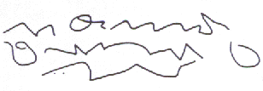
Stage 2
- scribbles but intends it as writing
- scribbling resembles writing
- holds and uses pencil like an adult

Slide 26
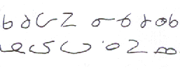
Stage 3
- shapes in writing actually resemble letters
- shapes are not actually letters
- look like poorly formed letters, but are unique creations

Slide 27
Stage 4
- uses letter sequences perhaps learned from his/her name
- may write the same letters in many ways
- long strings of letters in random order

Slide 28
Stage 5
- creates own spelling when conventional spelling is not known
- one letter may represent an entire syllable
- words may overlay
- may not use proper spacing
- as writing matures, more words are spelled conventionally
- as writing matures, perhaps only one or two letters invented or omitted

Slide 29
Stage 6
- usually resembles writing as we know it

Slide 30
Introducing Cursive Handwriting

Slide 31
Implications for us as a school
Labels/writing around the school must be cursive
Comments written in books must be modelled through the cursive script
Cursive script and presentation must be corrected and improved within written work
Support from you as partners in your child’s education

Slide 32
Progression in Handwriting
Take into account;
Gross and fine motor skills
Core strength
Dexterity
Pencil grip

Slide 33
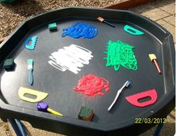
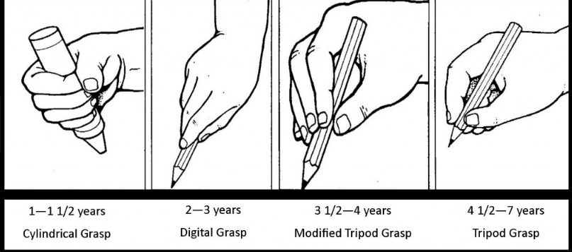
First Steps
Developing muscles needed for writing- information if you missed it the workshop a couple of weeks ago is on our website.
Mark making exploration and experiences

Slide 34
Cursive Unjoined

Slide 35
Cursive

Slide 36
Introduce Handwriting in Families
Curly Caterpillar family
c a f e s g o d q
Long ladder family
i l t u j y
One armed robot family
b h k m p r n
Zigzag monster family
v w x y

Slide 37
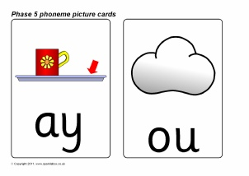
How does a cursive script link to phonics?
Children will be exposed to diagraphs and tri-graphs visually through flash cards and phonics sessions

Slide 38
Thank you for coming and we hope this evening has been informative.

